Slide 1

Security Compliances
Critical frameworks that protect your organization's digital assets and build trust with customers in an increasingly regulated world.

Slide 2

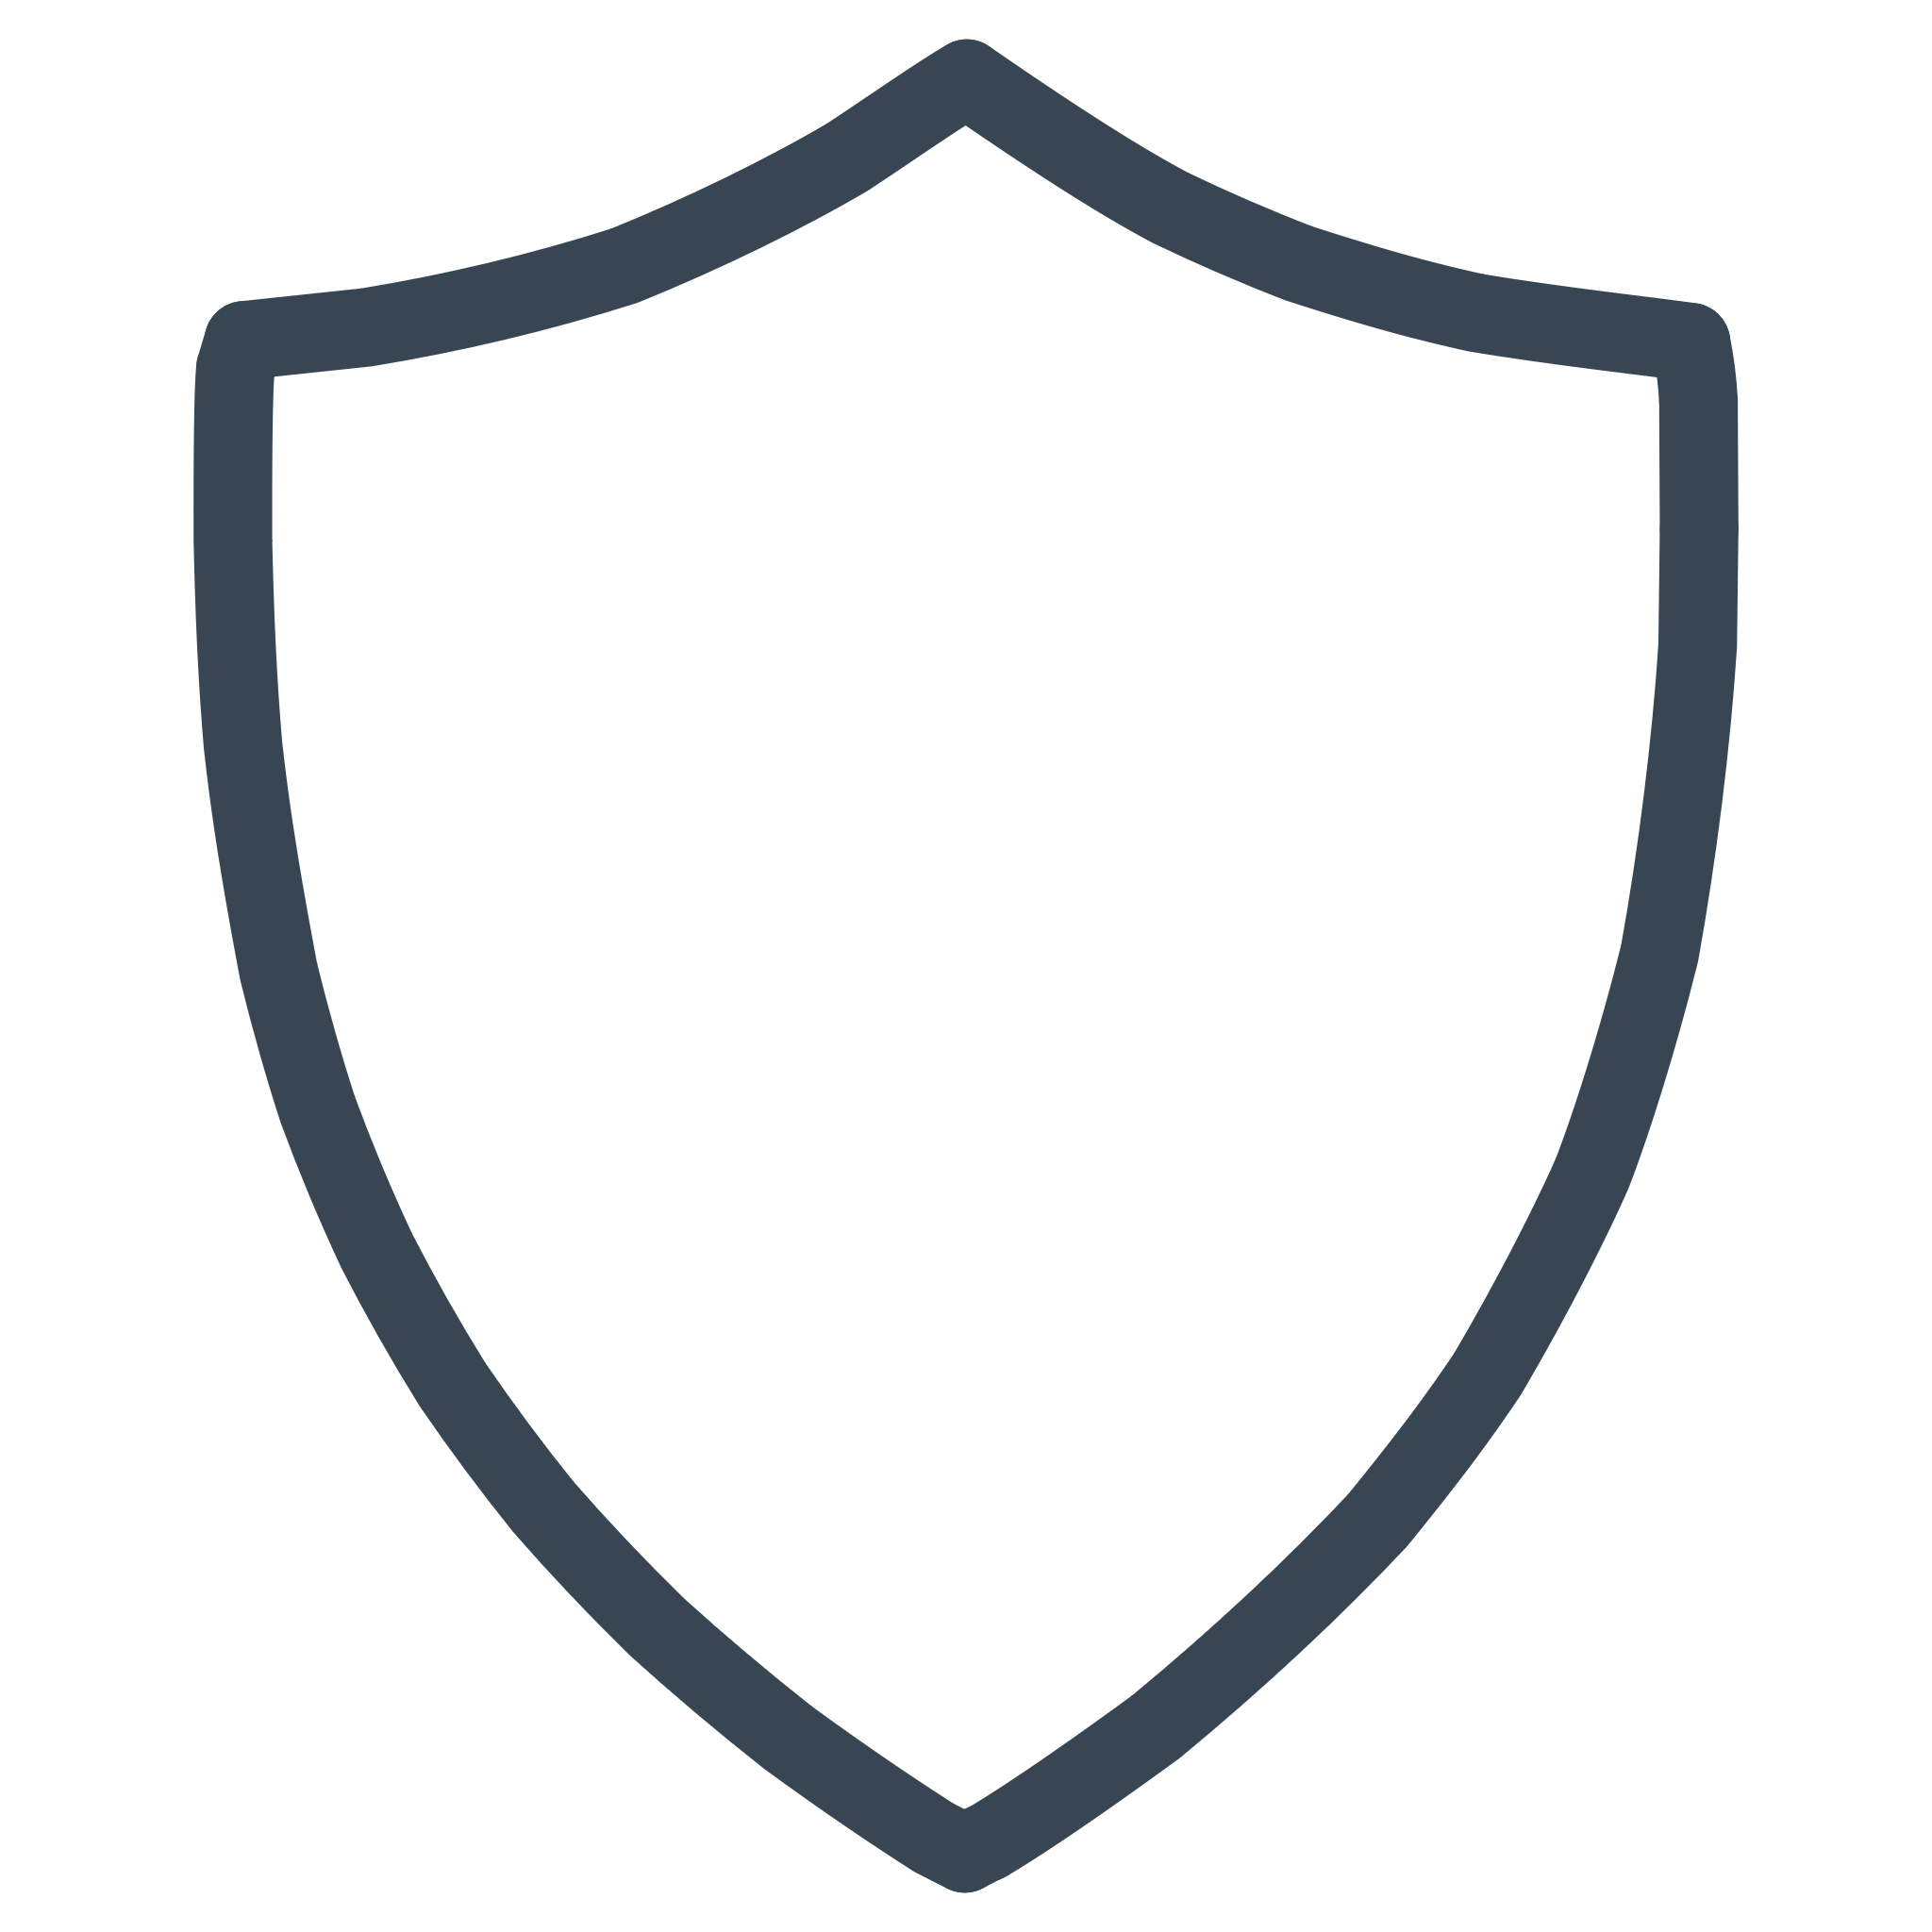
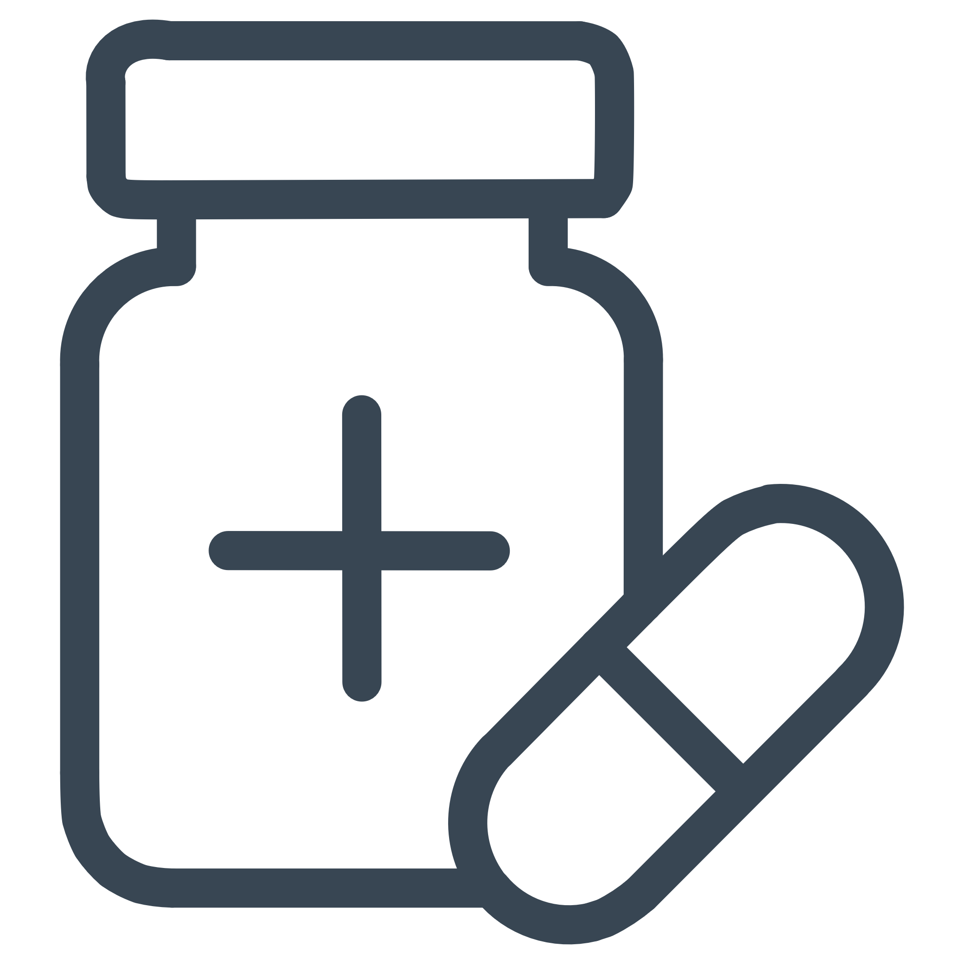
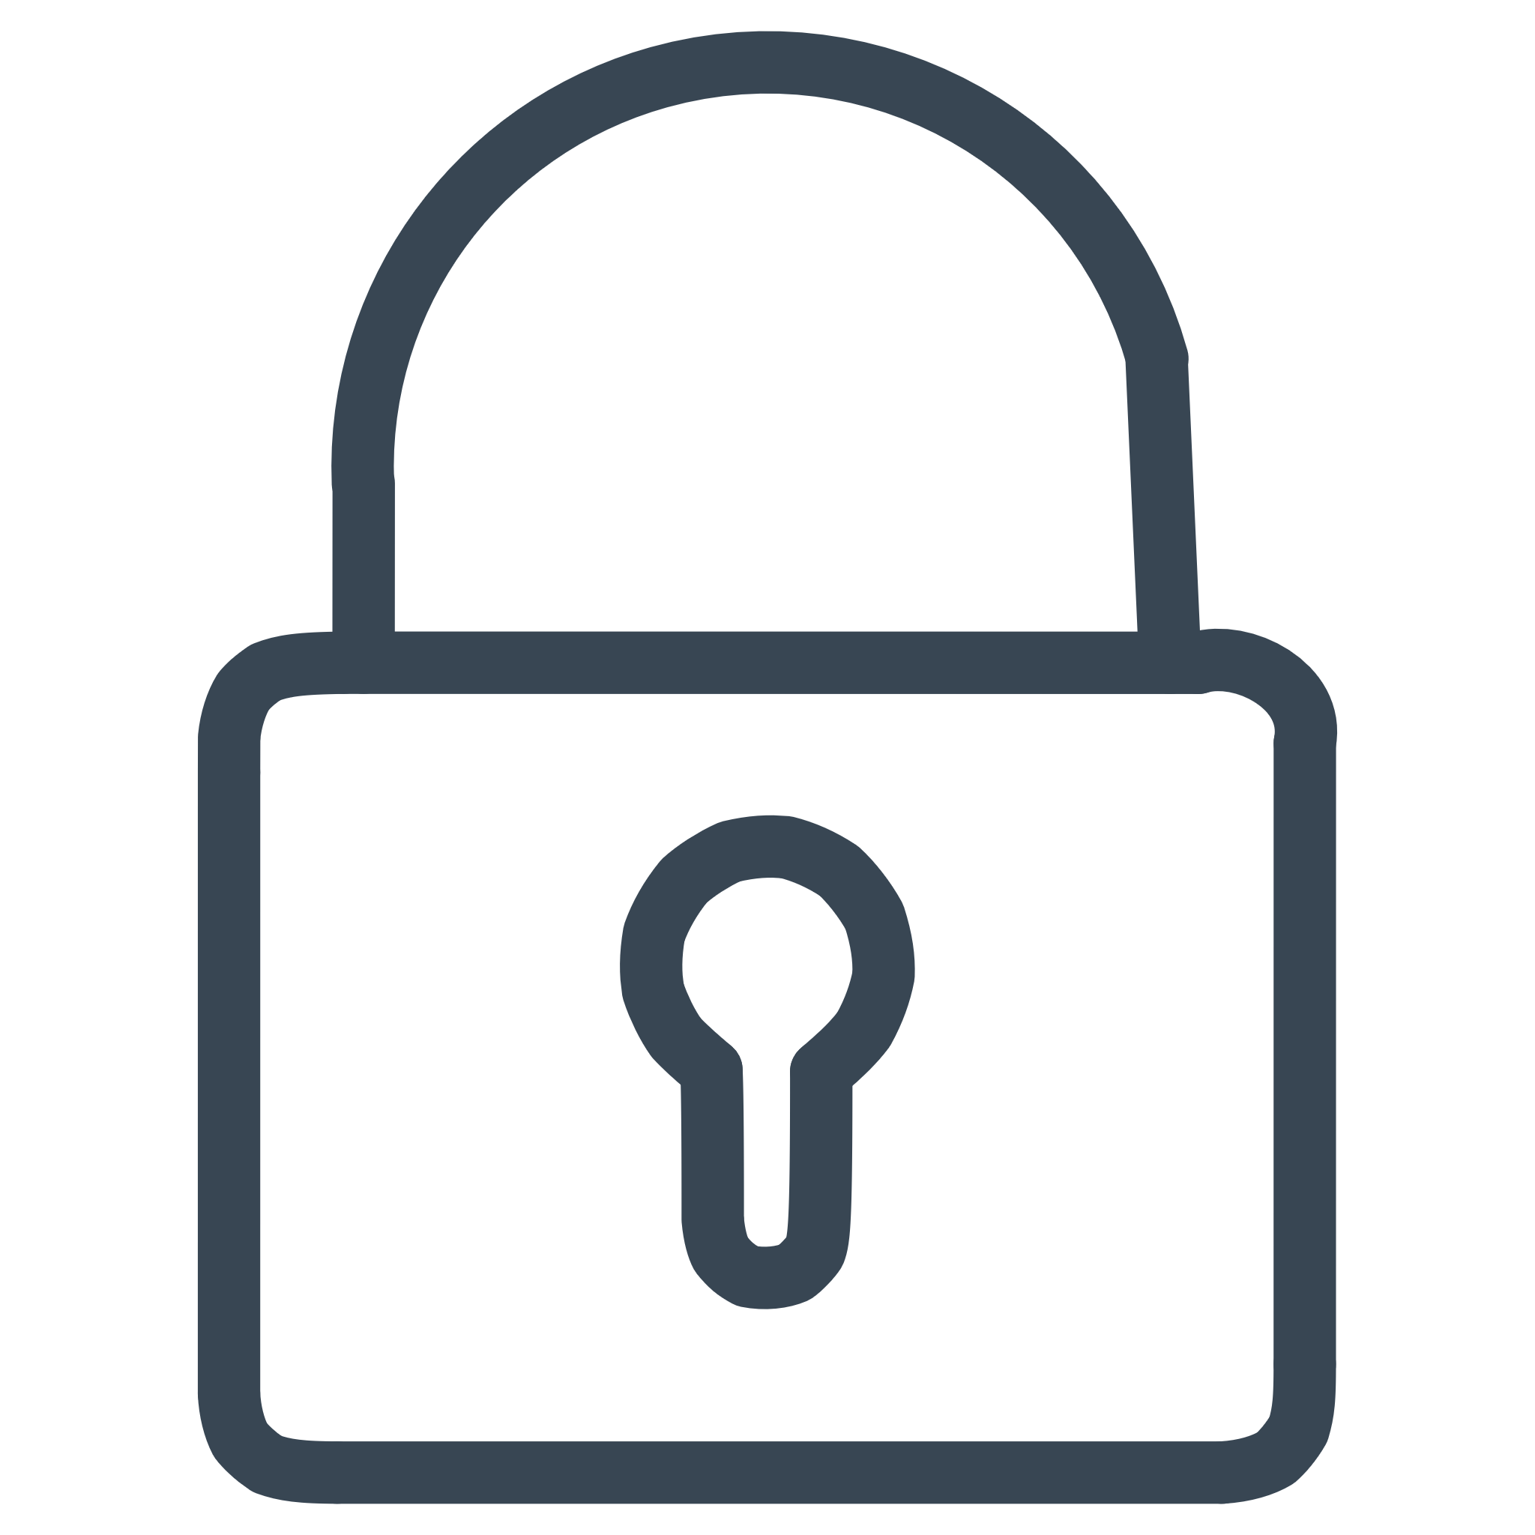
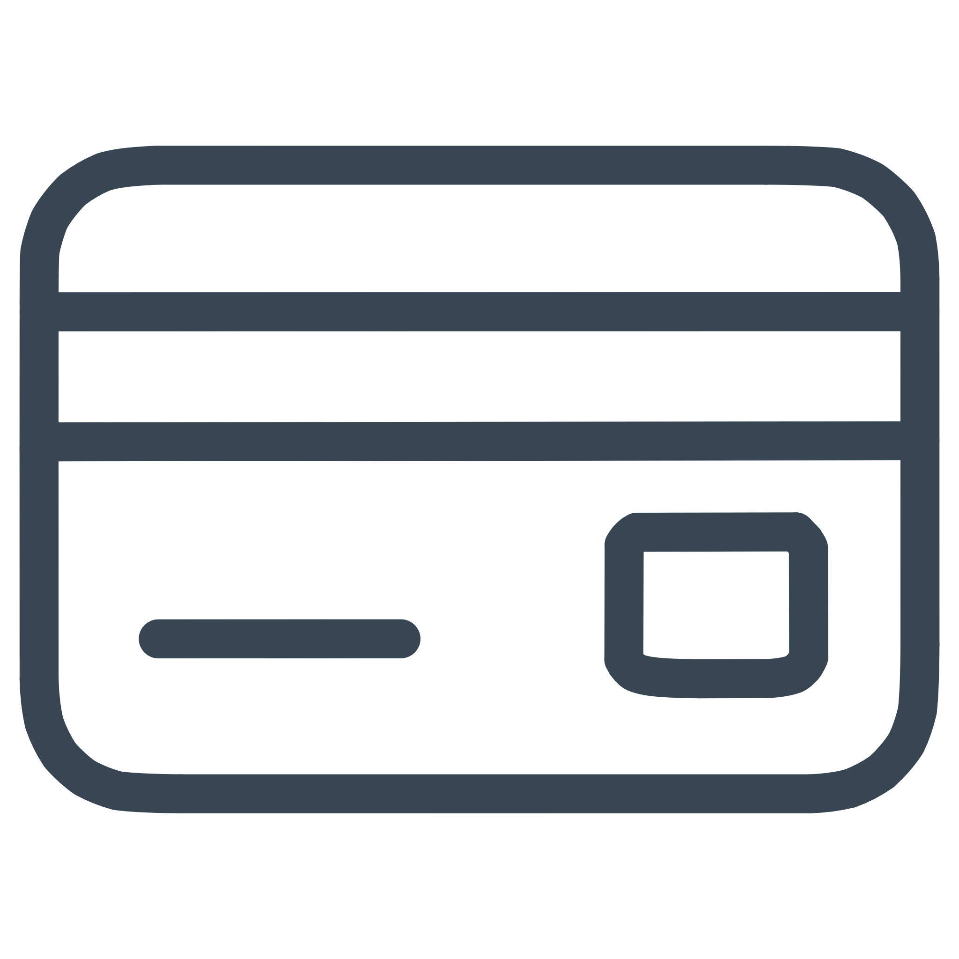
FOUNDATIONS
Defining Security Compliance
What It Means
Key Components
Security compliance means following laws, regulations, and industry standards specifically designed to protect sensitive data and IT systems from threats and unauthorized access.
Implementing technical and administrative controls to reduce operational risks
Meeting regulatory obligations through documented policies and procedures
Regular audits and assessments to verify adherence to standards
Continuous monitoring and improvement of security practices
GDPR
HIPAA
European data protection and privacy regulation
US healthcare information privacy standards
ISO 27001
PCI-DSS
International information security management
Payment card industry data security

Slide 3





CRITICAL IMPORTANCE
Why Security Compliance Matters
In today's digital landscape, security compliance has evolved from a checkbox exercise to a strategic imperative that directly impacts your organization's reputation, financial health, and operational continuity.
Data Protection
Customer Trust
Avoid Penalties
Enhanced Security
Safeguards sensitive information including personal identifiers, financial records, intellectual property, and health data from breaches, unauthorized access, and cyber attacks.
Demonstrates your commitment to data privacy and security, building confidence with clients, partners, and stakeholders who entrust you with their sensitive information.
Prevents costly fines and legal consequences. Non-compliance can result in millions of dollars in penalties, litigation expenses, and regulatory sanctions.
Strengthens your overall security posture against evolving cyber threats, creating multiple layers of defense and reducing vulnerability to sophisticated attacks.

Slide 4

Security vs. Compliance: Understanding the Difference
While often used interchangeably, security and compliance serve distinct but complementary roles in protecting your organization. Understanding this relationship is essential for building effective protection strategies.
Security
The comprehensive set of tools, technologies, and strategies organizations deploy to protect digital assets, networks, and systems from internal and external threats. This includes firewalls, encryption, access controls, intrusion detection systems, and incident response protocols.
Compliance
The specific rules, standards, and regulations that organizations must follow to meet legal, industry, and contractual requirements. Compliance provides the framework and benchmarks for implementing security measures according to established best practices.
Critical Insight: Being compliant doesn't automatically guarantee security, and being secure doesn't necessarily mean you're compliant. However, effective security programs leverage compliance frameworks as their foundation, using regulatory requirements as a baseline for comprehensive protection strategies.

Slide 5
GLOBAL STANDARDS
Key Security Compliance Regulations & Frameworks
Organizations today must navigate a complex landscape of regulations and frameworks, each designed to address specific industries, data types, or geographic regions. Here are the most influential standards shaping global compliance efforts.
GDPR (EU)
HIPAA (US)
PCI-DSS
General Data Protection Regulation enforces strict rules on personal data protection with global reach. Organizations worldwide must comply when handling EU citizens' data, facing fines up to €20 million or 4% of annual revenue.
Health Insurance Portability and Accountability Act protects patient health information in healthcare settings. Requires administrative, physical, and technical safeguards for electronic protected health information (ePHI).
Payment Card Industry Data Security Standard establishes security requirements for organizations that handle credit card transactions. Mandates encryption, access controls, and regular security testing to protect cardholder data.
ISO/IEC 27001
NIST Framework
International Standard for Information Security Management provides a systematic approach to managing sensitive information. Globally recognized certification demonstrating robust security practices across all organizational processes.
National Institute of Standards and Technology Cybersecurity Framework offers voluntary guidelines for managing cyber risks. Widely adopted across industries for its practical, risk-based approach to security.

Slide 6

REAL EXAMPLES
Real-World Impact of Compliance
Success Stories: Compliance Done Right
Microsoft 365 Data Protection
Healthcare HIPAA Excellence
Financial Sector Compliance
Ensures customer data remains private and secure through comprehensive encryption, access controls, and strict policies preventing data use for advertising purposes. Demonstrates industry-leading commitment to enterprise privacy standards.
Leading healthcare organizations avoid costly HIPAA violations by enforcing strict data access controls, conducting regular security training, implementing comprehensive audit trails, and maintaining robust business associate agreements with vendors.
Major financial firms comply with NYDFS cybersecurity regulations through continuous monitoring, regular penetration testing, and advanced threat detection systems to protect client assets and maintain market confidence.
The Cost of Non-Compliance
Companies have faced fines reaching hundreds of millions of dollars for data breaches resulting from inadequate security controls, insufficient employee training, and failure to implement required compliance measures. These penalties often accompany reputational damage, customer loss, and long-term business impacts that far exceed the initial fines.

Slide 7

Components of a Strong Security Compliance Program
Building an effective compliance program requires integrating multiple components into a cohesive strategy. Each element plays a vital role in creating a resilient security posture that meets regulatory requirements and protects against evolving threats.
01
Risk Assessment & Management
Systematically identify vulnerabilities, evaluate potential threats, and prioritize risks based on likelihood and impact to organizational assets.
02
Security Controls Implementation
Deploy technical and administrative safeguards aligned with relevant frameworks, including access controls, encryption, and incident response procedures.
03
Continuous Monitoring & Auditing
Establish ongoing surveillance of security systems, regular compliance audits, and real-time alerting to ensure sustained adherence to standards.
04
Employee Training & Awareness
Develop comprehensive security awareness programs to prevent human errors, the leading cause of security incidents and compliance violations.

Slide 8





BEST PRACTICES
Achieving Compliance
Successfully achieving and maintaining compliance requires more than understanding regulations—it demands a strategic, systematic approach to implementation, monitoring, and continuous improvement.
Regular Security Audits
Comprehensive Documentation
Dynamic Compliance Planning
Automated Monitoring Tools
Conduct both internal and external security audits on a scheduled basis to identify gaps, verify control effectiveness, and ensure alignment with current regulatory requirements. Third-party assessments provide objective validation of your compliance posture.
Maintain detailed logs, policies, and records that demonstrate accountability and provide evidence of compliance efforts. Documentation should cover security incidents, access requests, system changes, and training completion for audit readiness.
Leverage automation to continuously monitor compliance status, detect configuration drift, and identify gaps in real-time. Automated tools reduce manual effort, improve accuracy, and enable rapid response to compliance deviations.
Develop and regularly update a comprehensive compliance plan that addresses current regulations, emerging threats, and organizational changes. Your plan should include clear ownership, timelines, and success metrics for all compliance initiatives.

Slide 9




Challenges in Security Compliance
Organizations face numerous obstacles in their compliance journey. Understanding these challenges is the first step toward developing effective strategies to overcome them and maintain robust security postures.
Complex Regulations
Evolving Threats
Navigating overlapping and sometimes conflicting regulations across different regions, industries, and jurisdictions creates significant complexity for multinational organizations.
Keeping pace with rapidly evolving cyber threats and frequent regulatory updates requires constant vigilance, resource allocation, and program adjustments.
Remote Work
Coordination
Managing compliance across distributed, remote, and hybrid work environments introduces new risks around device security, network access, and data protection.
Ensuring consistent compliance across internal departments, external partners, and third-party vendors requires clear communication, accountability, and governance structures.

Slide 10

KEY TAKEAWAYS
Compliance as a Foundation for Security and Trust
Security compliance represents far more than a regulatory checkbox—it's a strategic investment in your organization's resilience, reputation, and long-term success in the digital economy.
Essential Protection
Continuous Journey
Competitive Advantage
Compliance is fundamental for protecting sensitive data, avoiding significant financial penalties, and maintaining customer confidence in an era of heightened privacy concerns and cyber threats.
Achieving compliance requires ongoing effort, cross-functional collaboration, and continuous adaptation to emerging risks, new regulations, and evolving business requirements.
Organizations that master compliance gain operational resilience, market differentiation, and a competitive edge as customers increasingly prioritize data security in their vendor selection.
Start building your comprehensive compliance program today to safeguard your organization's future and establish trust as your competitive differentiator.

